Slide 1
Python by smell
Advanced Python constructs for scientists
Pietro Berkes, Nagra Insight

Slide 2
What’s this smell?
Scientists in the wild tend to write this… (10’000 lines script; now it would be a notebook, same problem; codice del tipo dell’anno scorso?)
You’re here because you started feeling the “code smell” (a technical term)
I can show you that you already have the instinct: what is wrong with this code?

Slide 3
What’s this smell?
Qui codice ripetitivo, ask what is wrong
It’s the smell of functions! Same coded repeated over and over, it has to refactored in a function

Slide 4
What is wrong with smelly code?
Redundant, not flexible: an update in one place would need to be duplicated everywhere
Hard to test: the code that performs the interesting computation is mixed with the code that does the repetitive boilerblate

Slide 5
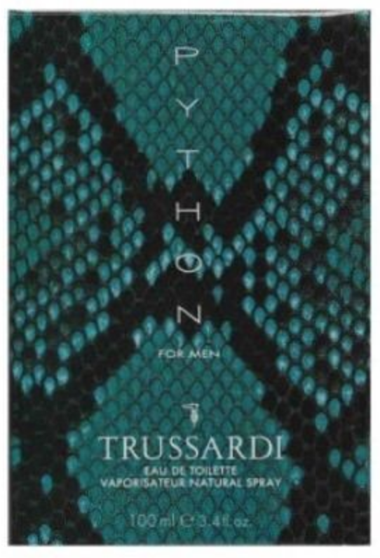
Objective
This is a code smell detection crash course for scientific programming
Advanced Python constructs are made to get rid of the smell!
These constructs are not very common in scientific code, and you don’t actually ”need” them. But the same is true for functions…

Slide 6
All the smells
The smell of generators
The smell of decorators
for ... :
# Transform / filter
for ... :
# Transform / filter
# The interesting part of the code
def my_function(x, y, z):
# Common boilerplate
# Function-specific part
# Common boilerplate
The smell of context managers
The smell of classes
# Prepare
try:
# The code you care about
finally:
# Clean up
def first_function(x, y, z):
# Something
def second_function(x, y, z):
# Something else
def third_function(x, y, z):
# Something more

Slide 7
The smell of generators
One or more nested loops, variables over which one iterates requires some extra transformation or filtering
for ... :
# Transform / filter
for ... :
# Transform / filter
# The interesting part of the code
This is the part that actually does some interesting computation. At the moment, it’s hard to test it!
… becomes …
for ... in my_generator():
# The interesting part of the code

Slide 8
The smell of decorators
Boilerplate code at the start and/or end of functions.
Typical cases: logging, deprecation, conditions checks, caching
def my_function(x, y, z):
# Boilerplate at start
# Function-specific part
# Boilerplate at end
This is the part that is specific to what the function actually does
… becomes …
@my_decorator
def my_function(x, y, z):
# Function-specific part

Slide 9
The smell of context managers
Before executing the code, something needs to happen: open a file, connect to a DB, initialize some hardware
# Initialize context
try:
# The code you care about
finally:
# Clean up context
Once the code has executed, we need to clean up, even if an error occurred: close the file, commit / revert SQL transactions, disconnect from hardware
… becomes …
with my_context_manager():
# The code you care about

Slide 10
The smell of classes
def first_function(x, y, z):
# Something
def second_function(x, y, z):
# Something else
def third_function(x, y, z):
# Something more
The same set of parameters is needed for a set of functions. In code calling this function, one needs extra code to keep these parameters in sync.
… becomes …
def first_function(xyz):
# Something
def second_function(xyz):
# Something else
def third_function(xyz):
# Something more
class Xyz:
def __init__(self, x, y, z):
...

Slide 11
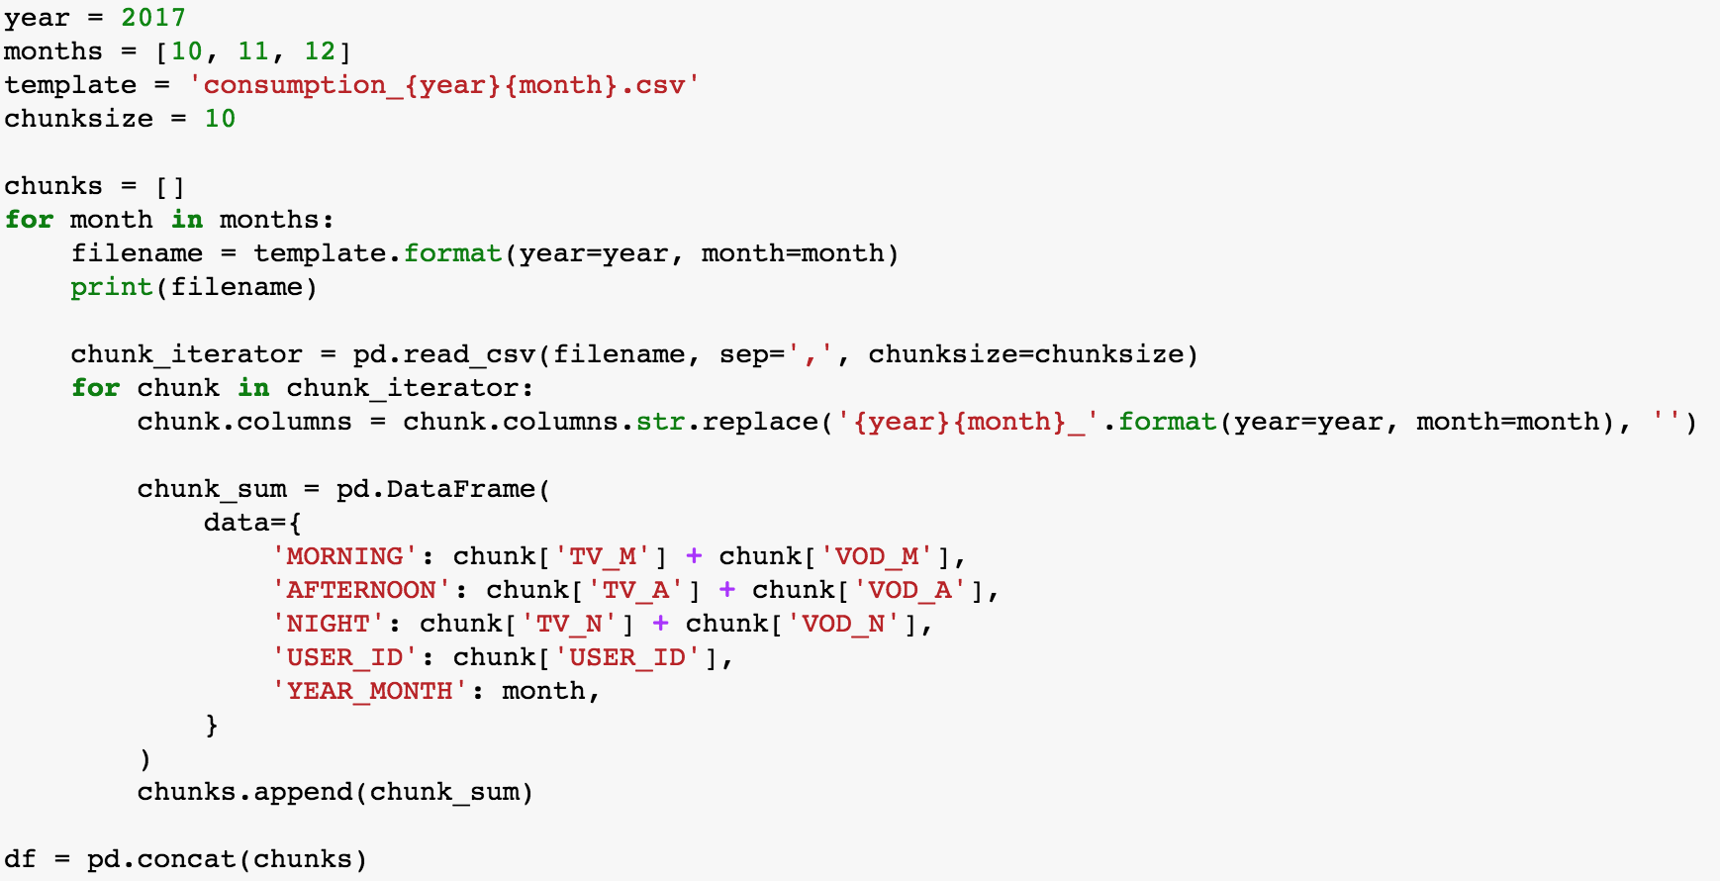
Example
Explain context…
Needed to do this for different years, with different computations
Testing this thing will require creating fake, messy files <- this is a complicated point to make, with a generator it requires mocking it…

Slide 12
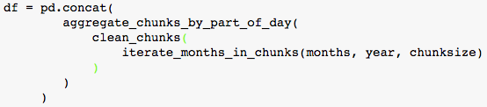
This is actually what we’d like to write.
All of this without actually loading all the data in memory for the intermediate steps!
Before getting here this we need to do a step back…

Slide 13
Python for loops are very flexible
Over lists
Over DataFrames
Over files
You can write your own thing to iterate over -> that is what generators are for!

